Slide 1
Sprint A
Group 1

Slide 2
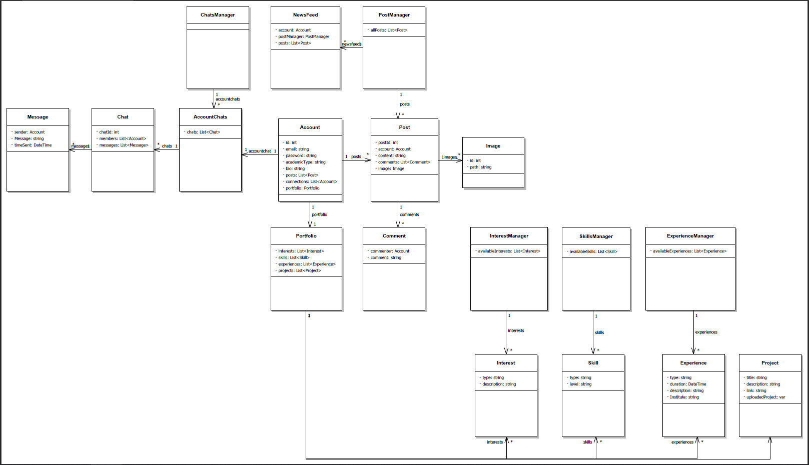
Datamodel

Slide 3
User Stories
User story 1:
As a user
I want to show of my projects on my profile
So that I can show of what I made
Acceptance criteria:
I can show of an infinite number of projects

Slide 4
User Stories
User story 2:
As a user
I want to show my personal information
So that people know who I am
Acceptance criteria:
It shows my name, age, country of birth, and languages.

Slide 5
User Stories
User story 3:
As a user
I want to specify the personal information that is visible for others
So that I only show what I want people to see
Acceptance criteria:
There are multiple levels of visibility so that I can select who can see my profile
Private: Only name and profile picture are visible
Friends only: Only friends(connections) can see posts and information about the user.
Public: All the information is accessible to the public.
You can change the visibility level of each section of your profile independently

Slide 6
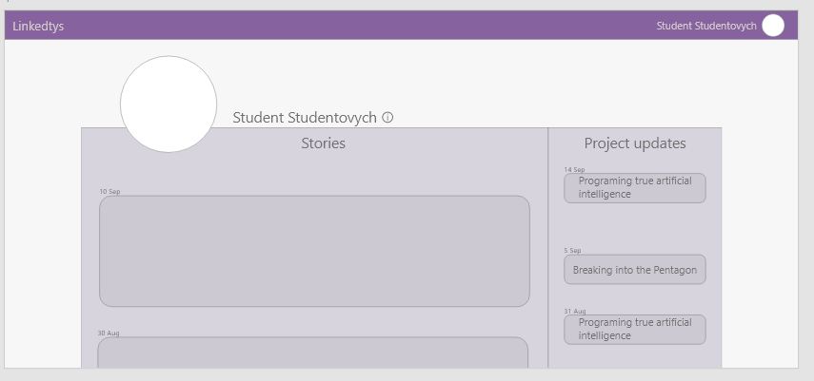
UI Demo

